Slide 1
SWINBURNE INNOVATION PRECINCT ACCELERATOR PROGRAM
2020 information night

Slide 2
TONIGHT
WHO ARE WE?
THE ACCELERATOR PROGRAM 2020
WHAT YOU NEED
APPLYING
FAQs

Slide 3
THE SWINBURNE INNOVATION PRECINCT
SEED START UPS
UPSKILL STUDENTS, ACADEMICS AND RESEARCHERS
GUIDE AND MENTOR ENTREPRENEURS & INNOVATORS
CATALYSE INNNOVATION & START OPPORTUNITIES
POSITION SWINBURNE AT THE GLOBAL FOREFRONT OF INNOVATION
PROVIDE A PATHWAY FOR THE ‘SWINBURNE FAMILY’ TO CAPITALISE ON THEIR IDEAS / IP AND CREATE A PIPELINE FOR COMMERCIALISATION OPPORTUNITIES
GIVE BACK TO THE START UP COMMUNITY

Slide 4
2020
ACCELERATOR
PROGRAM
The Accelerator Program is a 12- week program designed to help founders find their product-market fit and scale their ventures.

Slide 5
Validate market need
Solidify value proposition
Define business model
Improve business skills
Gain early traction
Focus on growth
Build networks
Drive customers & revenues
Path to investor readiness
PROGRAM GOALS

Slide 6
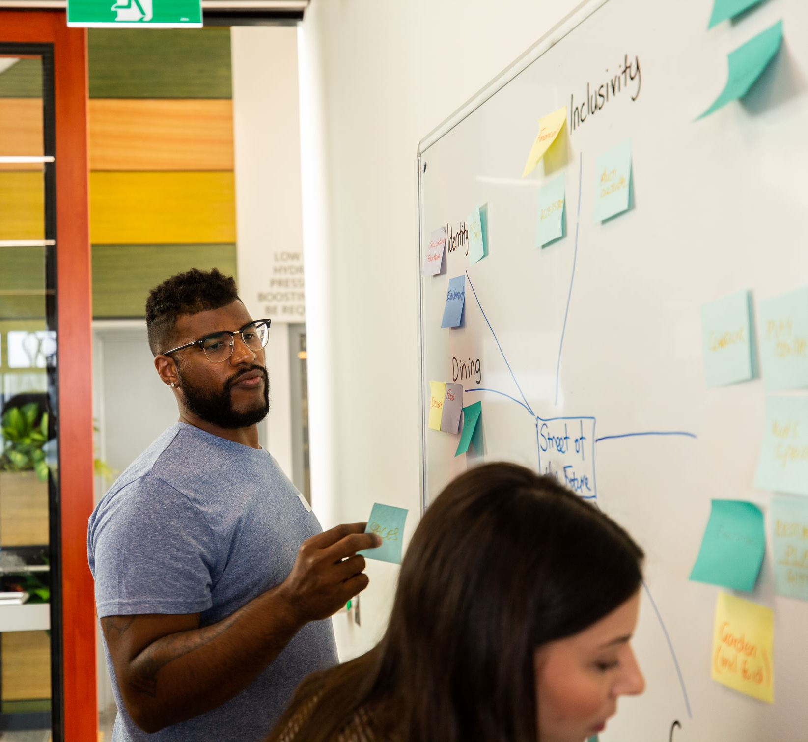
PROGRAM STRUCTURE
Activity schedule - Week 1 to 12
Each Monday and Wednesday online workshops
7 hours per week
3 1/2 hour masterclass / workshop – split into one 2 hour morning session and a 90 minute afternoon session
Mentor 1:1 sessions as planned by you and your mentor
Refined to match your businesses needs
Induction Day – 25 May
Meet the Innovation Precinct team and the other participants (via zoom)
Demo Day Showcase – 19 August (likely online at this stage)
Share how far you’ve come with our community of investors and supporters

Slide 7
WHAT WE EXPECT FROM YOU
ONLINE ATTENDANCE AND PARTICIPATION AT ALL PLANNED CONTENT SESSIONS (1 FOUNDER)
ADHERE TO LEGAL AND CONTRACTUAL OBLIGATIONS
BRING AN OPEN MIND AND COLLABORATIVE APPROACH

Slide 8
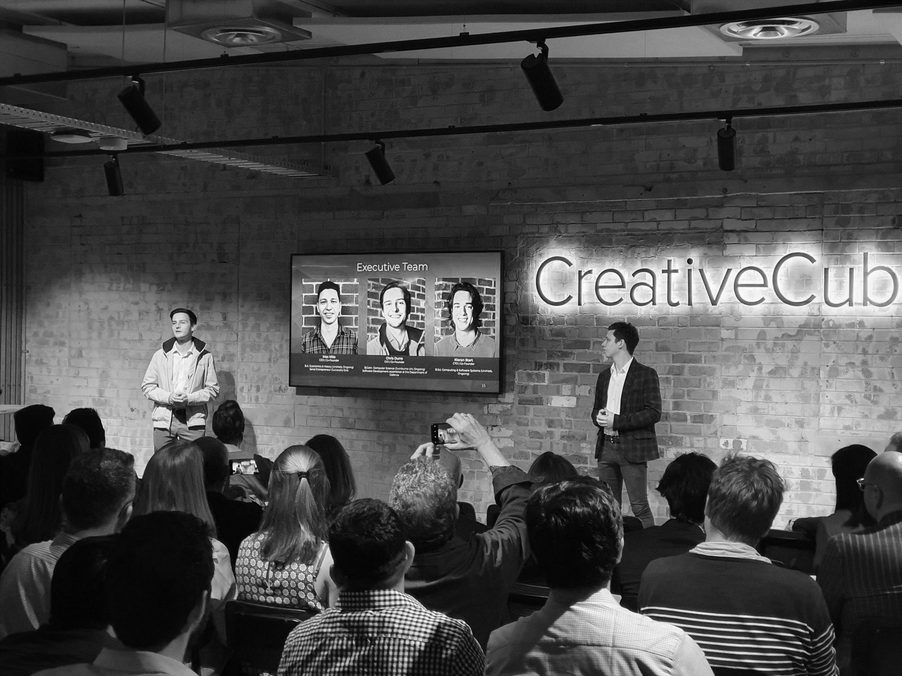
$30,000 CAPITAL (EQUITY FREE)
$10,000 FREE ACCOUNTING (WILLIAM BUCK)
LEGAL TEMPLATES (CORRS CHAMBERS WESTGARTH)
$15,000 FREE CLOUD SERVICES (AWS)
$150,000 FOREX TRANSACTIONS FEE FREE (AIRWALLEX)
WORLD CLASS MENTORS & PRESENTERS
ENTREPRENEURS IN RESIDENCE FOR SUPPORT
WHAT YOU
GET
IN RETURN

Slide 9
WELCOME & PROCESS
STORY TELLING
FOUNDER RESILIENCE
VIRAL PATHWAYS INTRO
VALUES & ETHICS
ANALYSING YOUR MARKET
CUSTOMER DISCOVERY
COGNITIVE DISSONANCE
BUSINESS MODELS
SOCIAL IMPACT
CULTURE
MASTERCLASS - 1
STRATEGIC ARCHITECTURE W/S
2020
ACCELERATOR
CONTENT
SCHEDULE
MODULE 1
FOUNDATION
MONTH
ACCOUNTING FOR FOUNDERS
FINANCIAL STRUCTURES
EFFECTIVE DASHBOARDS
GOVERNMENT GRANTS
PATH TO VALUE
INVESTMENT 101
DUE DILIGENCE
MASTERCLASS -2
GOVERNANCE
BUILDING A BOARD
UNDERSTANDING IP
ARE YOU READY TO SCALE
DEMO DAY BRIEF
MENTOR Q&A
HOW TO PITCH
PEER PITCHING SESSION
MODULE 2
STRUCTURE
MONTH
MARKETING TOOLKIT
BUILDING A BRAND
MARKETING CAMPAIGNS
PR & SOCIAL MEDIA
CHANNELS TO MARKET
SALES STRATEGY
BUILDING YOUR SALES KIT
HIRING GREAT TEAMS
PITCH TRAINING
PITCH REFINEMENT
Q&A PITCH SESSION
ENTREPRENEUR MASTERCLASS
VIRAL PATHWAY CHECK IN
DEMO DAY SHOWCASE
MENTOR Q&A
MODULE 3
GROWTH
MONTH

Slide 10
WE ARE LOOKING FOR
SWINBURNE FAMILY: STAFF, STUDENTS, ALUMNI
CLEAR BUSINESS IDEA
WELL ARTICULATED MARKET OPPORTUNITY
PRODUCT MVP / PROTOTYPE
IDEALLY A CUSTOMER / USER (DOES NOT HAVE TO BE PAYING)

Slide 11
Progress to date
WHAT KEY MILESTONES HAS YOUR STARTUP HIT?
COMPLETED
# CUSTOMER INTERVIEWS?
BUILT YOUR MINIMUM VIABLE PRODUCT?
STARTED SELLING IN MARKET?
USER TESTIMONIALS OR NET PROMOTER SCORES?
SECURED PARTNERSHIPS?
MENTIONED IN THE MEDIA / PRESS?
HAVE YOU LAUNCHED A WEBSITE?
LAUNCHED YOUR BETA PRODUCT?
GENERATED CUSTOMERS & REVENUE?
USER METRICS?
WON ANY AWARDS?
PRODUCT TRIALS VALIDATED YOUR MODEL?

Slide 12
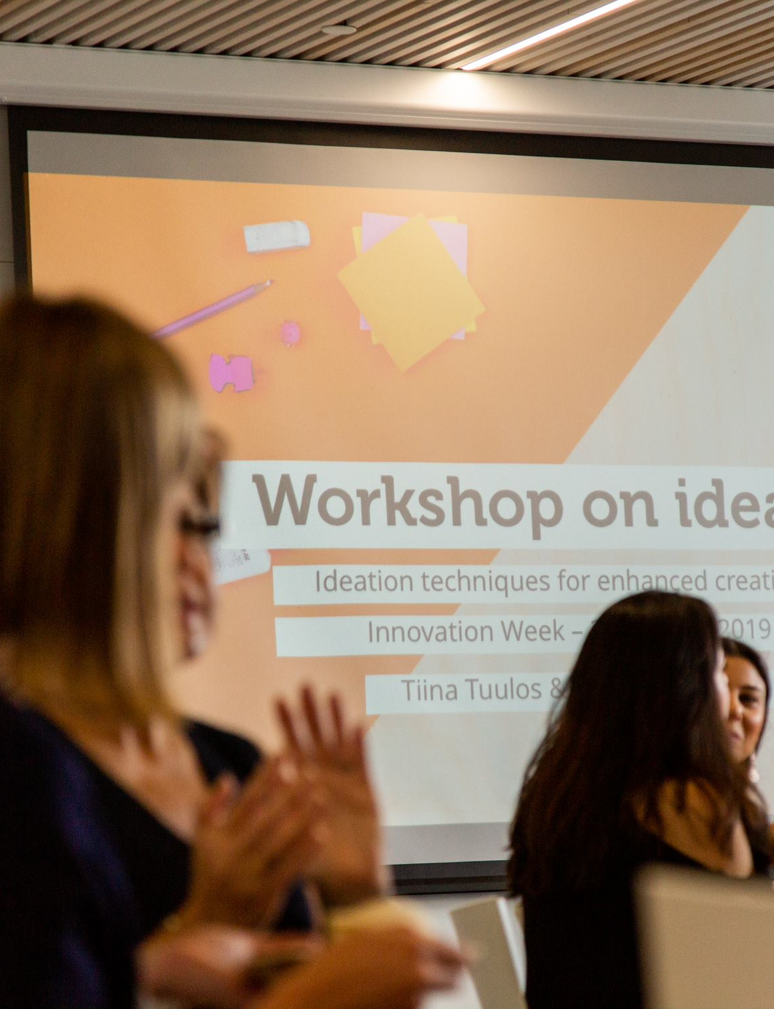
APPLYING
3-4 minute video – consider this your winning pitch!
Prepare and practice, keep it concise, focused and well timed
Tell us your start up story, including:
Who are the founders/cofounders, investors & your Swinburne relationship?
Why you? Why this team?
What is your business, why are you unique and how will this scale-up?
Who is your target audience and why does your product/solution fit?
What is your stage as a start up. Be clear on product status, MVP experiments, numbers of customers and revenue status?
What is the most important thing that you need to take your company to the next “level”? (If it’s money, how will you use the money?)
Explain your total accessible market and the market you plan to initially target.
APPLICATIONS CLOSE FRIDAY APRIL 10 @ MIDNIGHT

Slide 13
Your video pitch
Tips:
Know your what, why & how
prepare a script early, iterate, iterate, iterate
Find a hook to Connect with your audience
Answer the major questions, don’t leave us hanging

Slide 14
Online INTERVIEW SCHEDULE
ROUND 1
INTERVIEWS
FINALIST
INTERVIEWS
NOTIFICATION
Interviews 14 May
daytime, 20 minutes each
A due diligence form will be provided prior to the interview date for applicants to complete and return
This is a Q&A interview with our Accelerator Program team
Interviews 20 May
daytime, 45 minutes each
We look at your business plan, program needs and goals
All finalist applicants notified of the outcome 21 MAY

Slide 15
SOME FREQUENTLY ASKED QUESTIONs
Who needs to be from Swinburne in my team?
At least one founder must be staff, student or alumni (Swinburne Family).
What if my business is overseas?
You will be required to participate in all sessions and your seed funding will need to paid to an Australian business with an ABN.
How many of our team members must participate the Accelerator?
At least one founder must participate every session.
Do we have to be onsite at the Fire Station?
Due to the current environment, we will be transitioning to interactive online sessions rather than face to face.
Must we participate in all workshops and activities?
Yes, as least one founder must participate in every session.
Are there any costs to do the Accelerator?
The only cost is a working with children check which will only be required if we return to on campus participation
Must I already have an MVP and market traction?
Ideally you would have both or at least an MVP and well-defined path to market.
What do you define as a start up?
A registered business that has yet to take series A funding and has been operating less than 18 months.
Do you accept social enterprise?
We sure do ☺
How does the $30,000 seed funding work? When do we get the money?
The funding is made available after week 3 is completed and you have demonstrated a clear commitment to engage in the accelerator programs. You will be required to provide an invoice to the Innovation Precinct.
You are required to have an ABN and a Bank Account clearly associated with this ABN. The money will be paid into this Bank Account.
Does Swinburne take equity?
No ☺ - HOW AWESOME ARE WE?!?!?!?!
What if we are Swinburne staff, how does intellectual property work?
You retain full ownership of all intellectual property (IP). There is an exception for Swinburne staff, who should seek advice on their specific projects. We encourage you to discuss your intellectual property with the University Patent Attorney: Alice Wong - alwong@swin.edu.au

Slide 16
RIGHT NOW
APPLICATIONS ARE OPEN
7 MAY @MIDNIGHT
APPLICATIONS CLOSE
14 MAY
FIRST ROUND INTERVIEWS
20 MAY
FINAL ROUND INTERVIEWS
KEY DATES
25 MAY
INDUCTION
27 MAY
WEEK 1 COMMENCES
26 AUGUST – DEMO DAY SHOWCASE. SHOW TIME.

Slide 17
Any
other
Questions?

Slide 18
Thank you

